Slide 1
Bank System Project
Adham Mohamed Hassan – 19100821 – Class: F
Ahmed Salah Elsayed – 19102372 – Class: F
Moataz Mahmoud Elsayed – 19103233 – Class: F

Slide 2
Objectives
Presenting and describing the whole process of the AAM bank system.
Services the application provides.
Providing an aesthetics layout and interesting forms.

Slide 3
Presenting and describing the whole process of the AAM bank system.
Login - Signup:
Login: Customer
Manager
Staff
Sign Up:
Fill data
Choose Account type

Slide 4
Services the application provides.
Customer:
Checking Balance
Deposit
Withdraw
Manager:
Hire
Fire

Slide 5

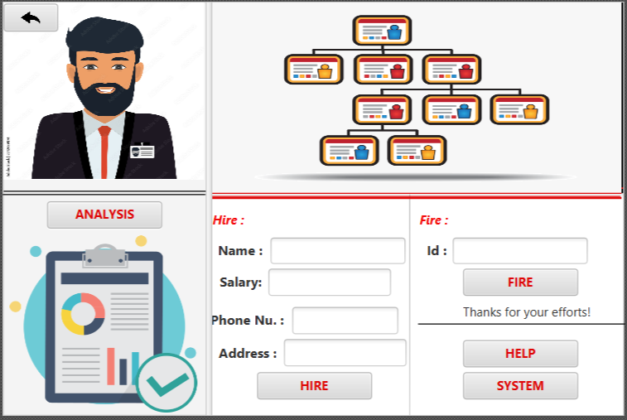

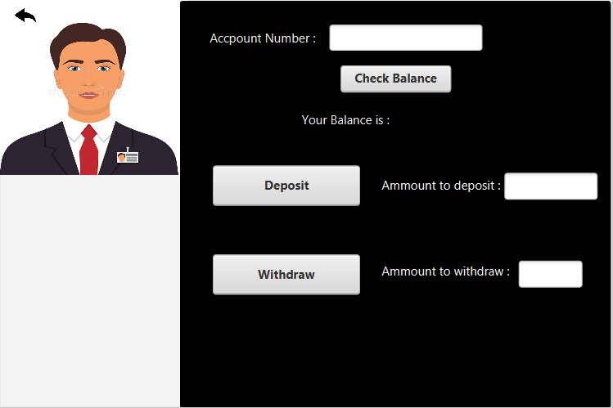
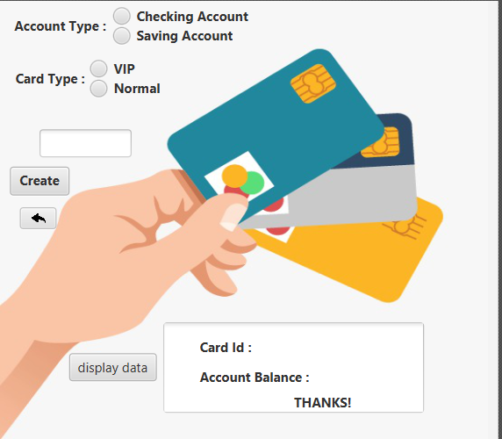
Providing an aesthetics layout and interesting forms.

